Slide 1
ENSE 374, Milestone 4
4/12/2019
Daniel Takyi
Jiwoun Kim
Mason Lane

Slide 2
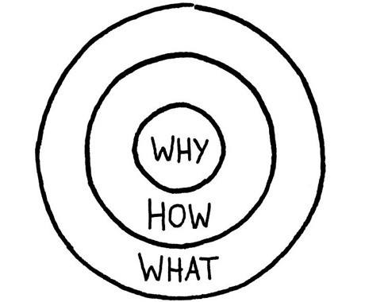
Golden Circle
Why?: We’re bad at making decisions, indecisive. We want something to help.
Some of us are bored, seeking something unique.
How?: We would like something that might help us form and explore decisions; something fun.
What?: We propose a random list of generated venue locations within a city. Expanding on apps like “wheel decide”.

Slide 3
Team: They Will
We’re creating a web-app that provides random venues for a user to explore.
People should be able to garner a random list of curated results after entering various search parameters.
Sometimes decisions are hard - sometimes we worry. What if we miss out on something? Everyone lives with regrets. Many people find themselves wondering what curiosities they’ve overlooked or missed. This application will grant users the opportunity to discover and enjoy new experiences by suggesting random food locations. It will help the indecisive make quick novel decisions, or simply grant the experimental types new adventures to behold.
Ultimately, it should be something that can help us make decisions and explore; simple to use and convenient.
https://github.com/jiwoone/ENSE-374-Project

Slide 4

Review the project vision
We are not just a search engine
Our app is unique in that it tells you exactly where to do
We do not list everything, and we do not propose ‘genres’ of food
Our app gives you a precise recommendation
We are Currently the only software that offers this functionality
We had competition, but their site is down
Appears no one else is doing what we're doing

Slide 5
Team work/responsibilities
Daniel : View in MVC - data presentation as well as help/about pages. Lead the majority of art direction and lofis
Jiwoun : Model in MVC - implemented the sending of queries to the google maps/places API, listing the retrieved information and synchronizing markers on the map. Lead the initial architecture plans. Implemented first iteration of menu options
Mason : Controler in MVC - added control functions to manipulate search results. Optimized site for small devices, and enabled query system to use input settings. Implemented scrolling menu options
As a team, we noticed our work behavior was similar to that of a scrum team. Specifically, our work often spilled into eachothers as we went from .html, to .js and .css.

Slide 6
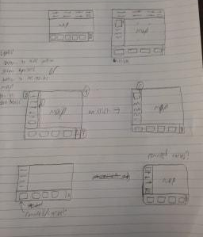
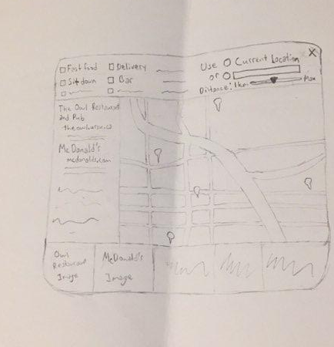
FRD for our Filter Options

Slide 7
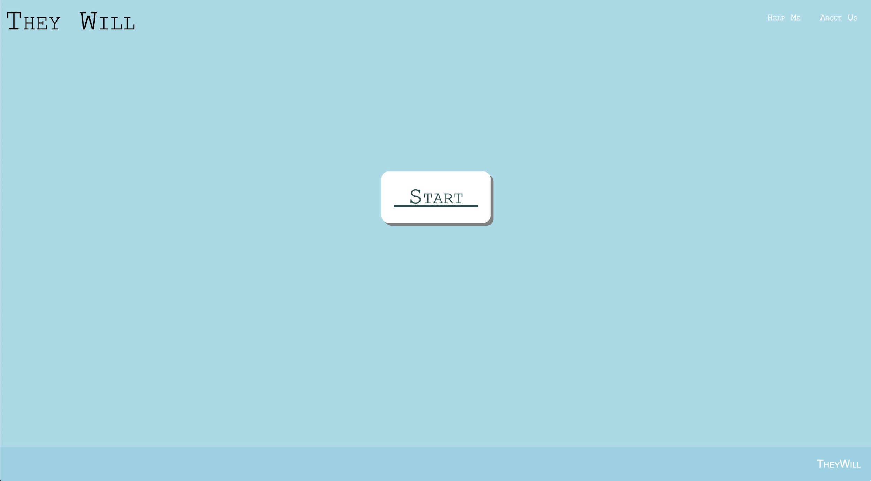
MVP 2 demo

Slide 8
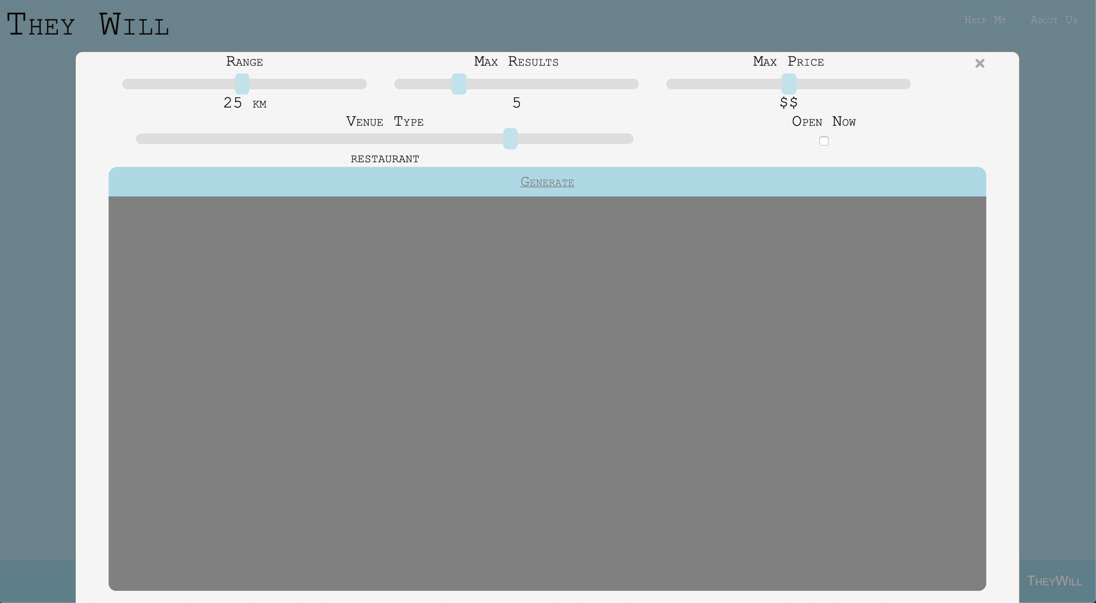
MVP 2 demo

Slide 9
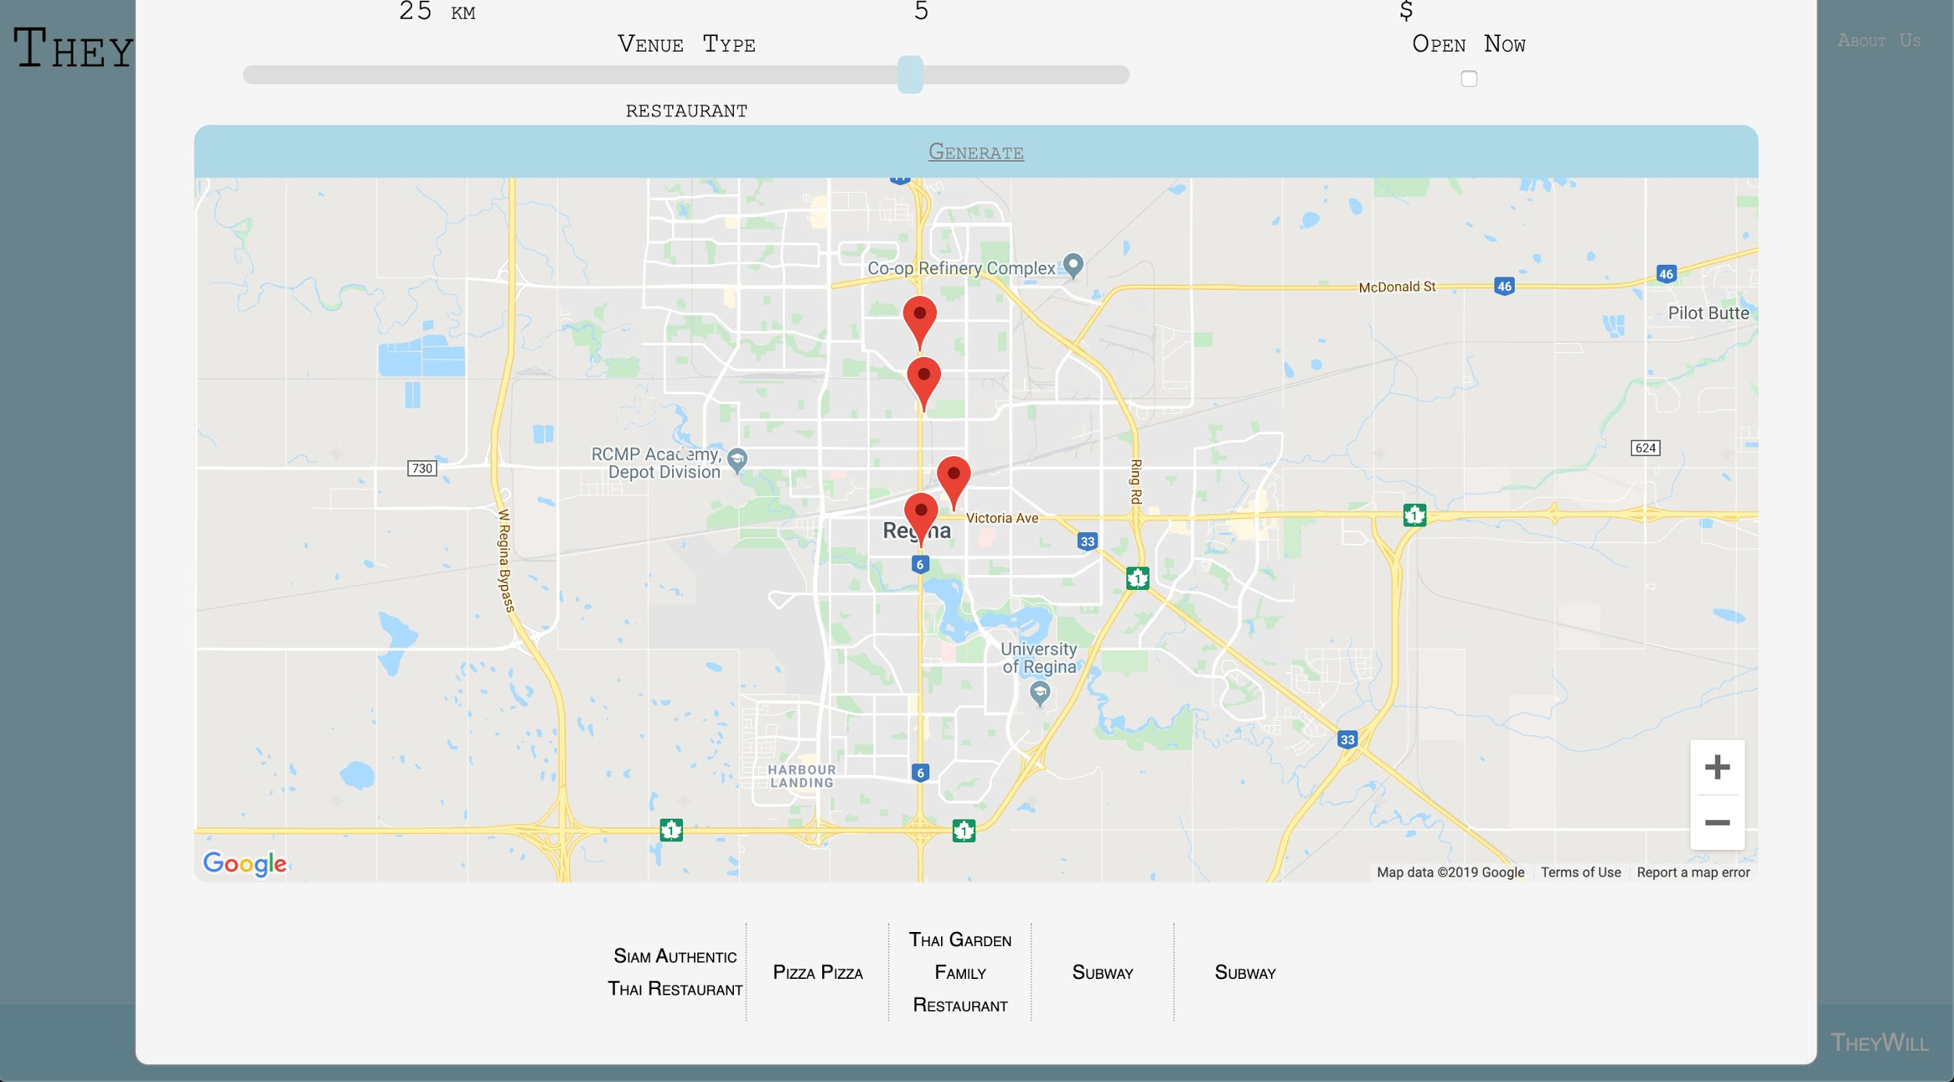
MVP 2 demo

Slide 10
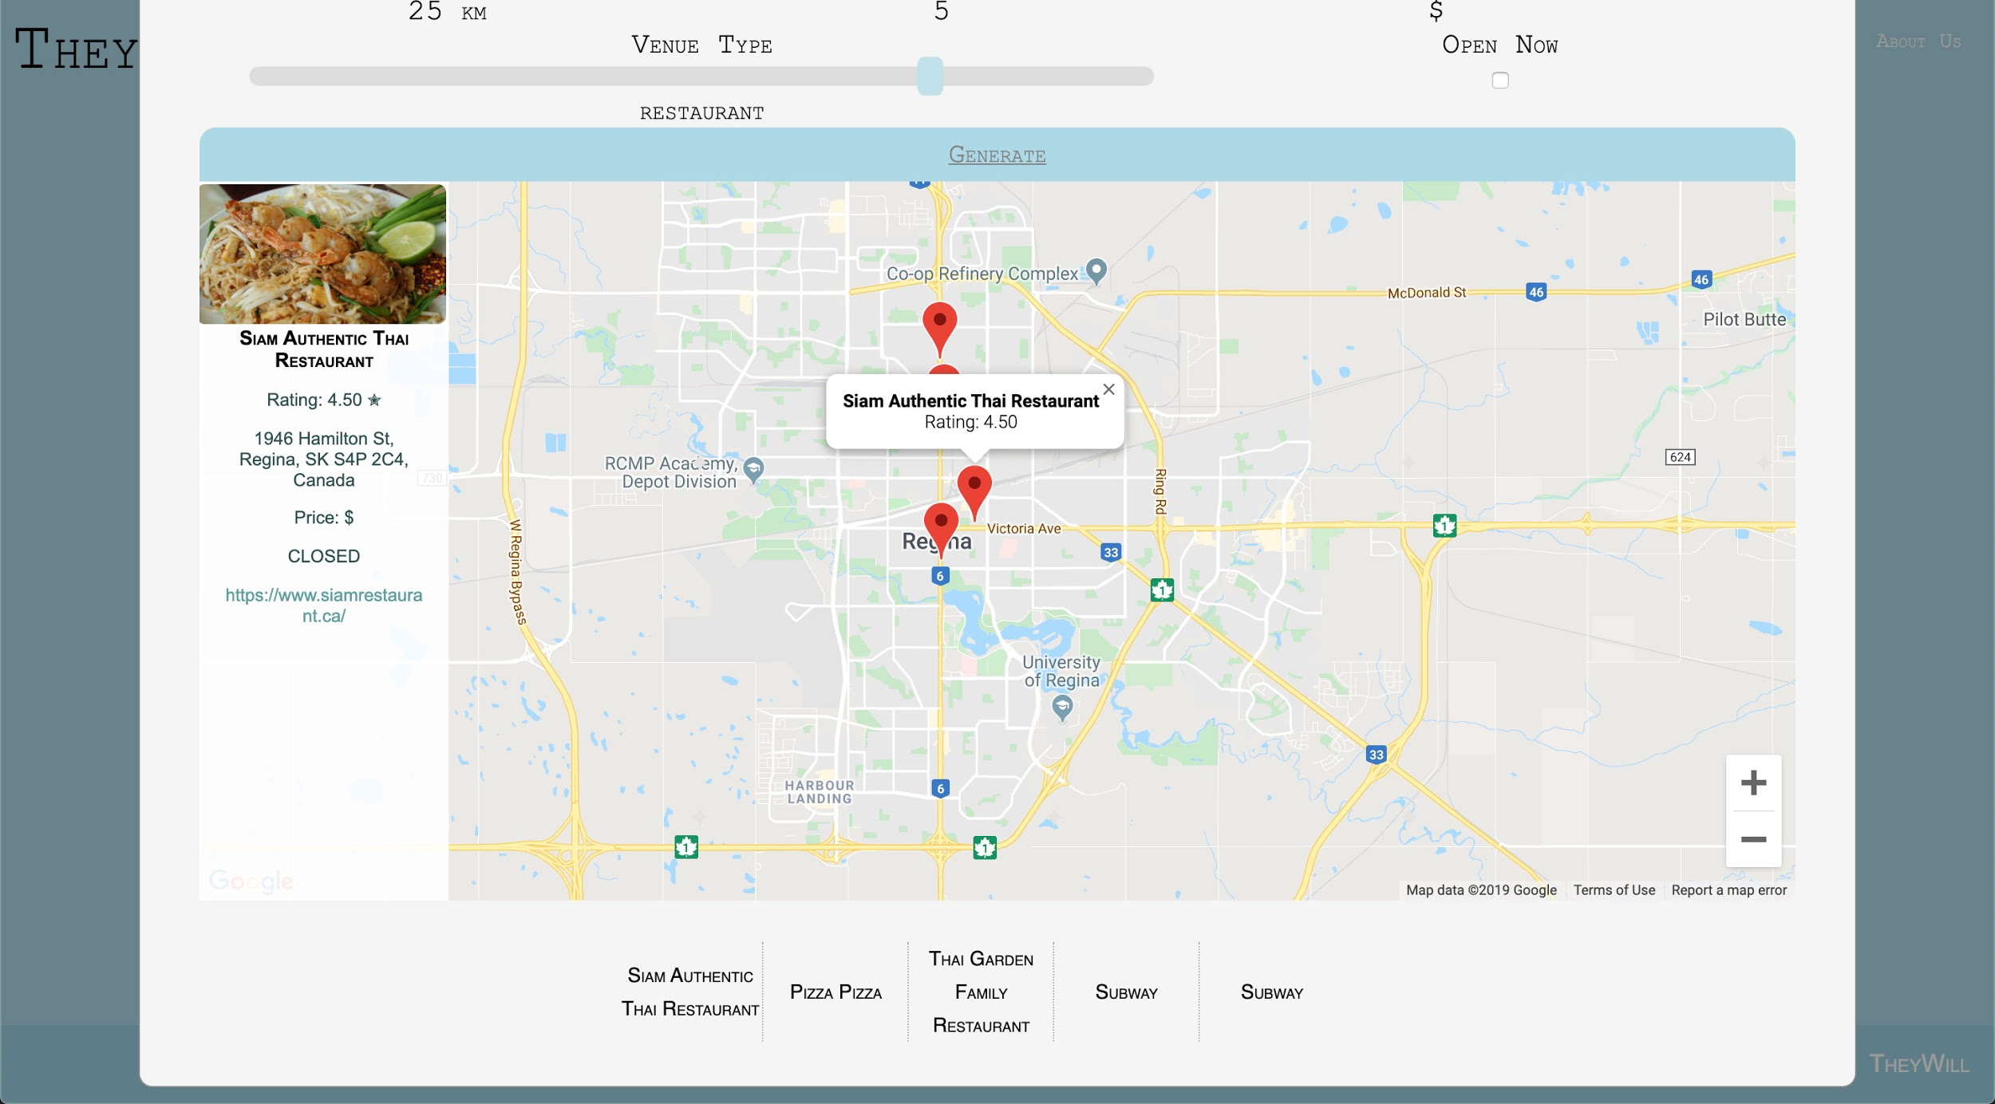
MVP 2 demo

Slide 11
MVP 2 demo
App feels complete- performing all intended functions
First university software project with an end result or ‘bigger picture
It actually has substance, feeling like something we could monetize
What needs fixing?
Scroll menu buttons are too long
Text sizing is not perfect and is unreliable for certain devices
Menu options (on the top or left pane?)
Geolocation bug
Code tidiness, architecture document update.
Notes:
Look and feel of the application : It looks way better than the first MVP
This would be said the more developed application ever because this is not a ‘minimum’ viable product anymore. It does have functions we discussed in MVP 1

Slide 12
Looking back
We believe our project fills an untapped niche, and have successfully made it a viable product
Of our achievements, we appreciate the following the most
Elegant UI
Successful interaction with and manipulation of the Google Places/Maps API
Admirable efforts to make software compatible with small devices
Crossroads
What was our app going to do? How does it carve itself a place on the internet?
Discovering the ease of Jquery
How our filter menu would appear
Is our code clean?
Oh god, not at all

Slide 13
Future MVPs
We have met every goal we put forward, and have implemented a search option for every relevant category made available by the google places api
First, cleaning our code would take precedence. Infact, it could benefit from being a sprint of its own entirely.
From there, we could consider alternative search options (like using google Place’s Rader instead of getPlaces())
More importantly, improved UI and small device scaling would be beneficial
Finally, algorithms of our own for storing and applying choice bias based on other factors (popularity, etc)
Host an HTTPs web server, allowing us to secure our API
Redesign menu (what is more friendly? A top or side pane menu?)

Slide 14
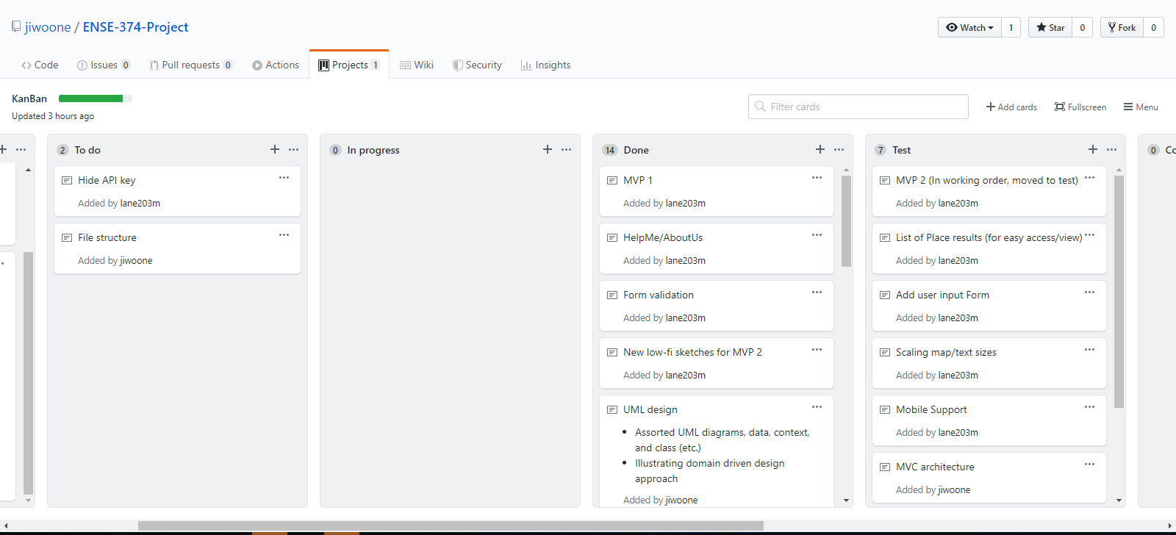
Github
https://github.com/jiwoone/ENSE-374-Project/projects/1

Slide 15
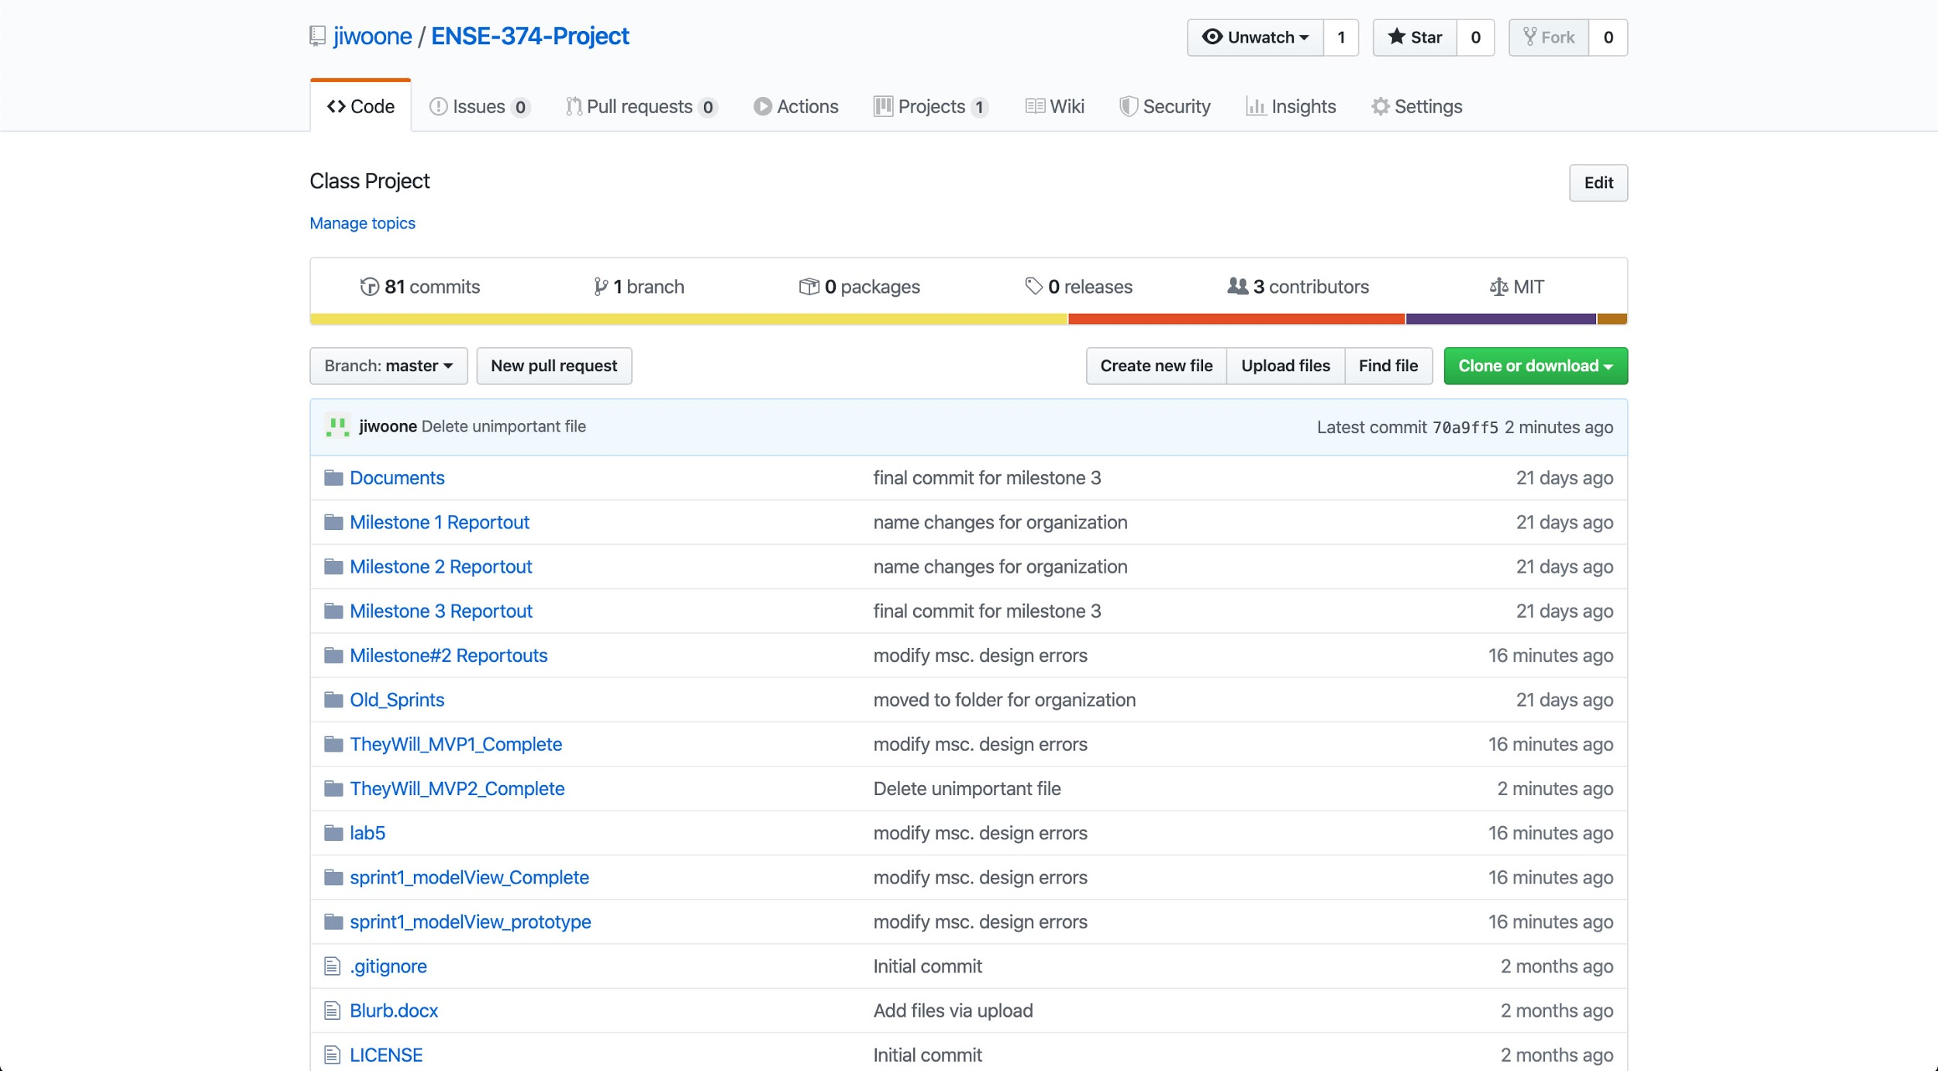
Github

Slide 16
Group reflection
How did you feel about this project? What did you like about it? What did you dislike?
We enjoyed working with google maps and the places API, though found css was hard to make ‘just right’
Felt meaningful, and applied
What did you learn about yourself as you collaborated and worked through this project?
It was difficult staying within predefined boundaries/duties. Like any scrum team, we found ourselves building around each other.
How will you use what you have learned going forward?
Jiwoun: Divide and Conquer was the best strategy for me to solve javascript problems on the project. I think this will work on some repetitive programming problems as well.
While not impacting us in this project, its evident how messy code can be a time bomb
What “stuff & things” related to this project would you want help with? – Could have been better?
Some of us would like to understand CSS to a greater degree
Learning more about Jquery and its applications
How can we improve UI for all device shapes
https://github.com/jiwoone/ENSE-374-Project

